Slide 1
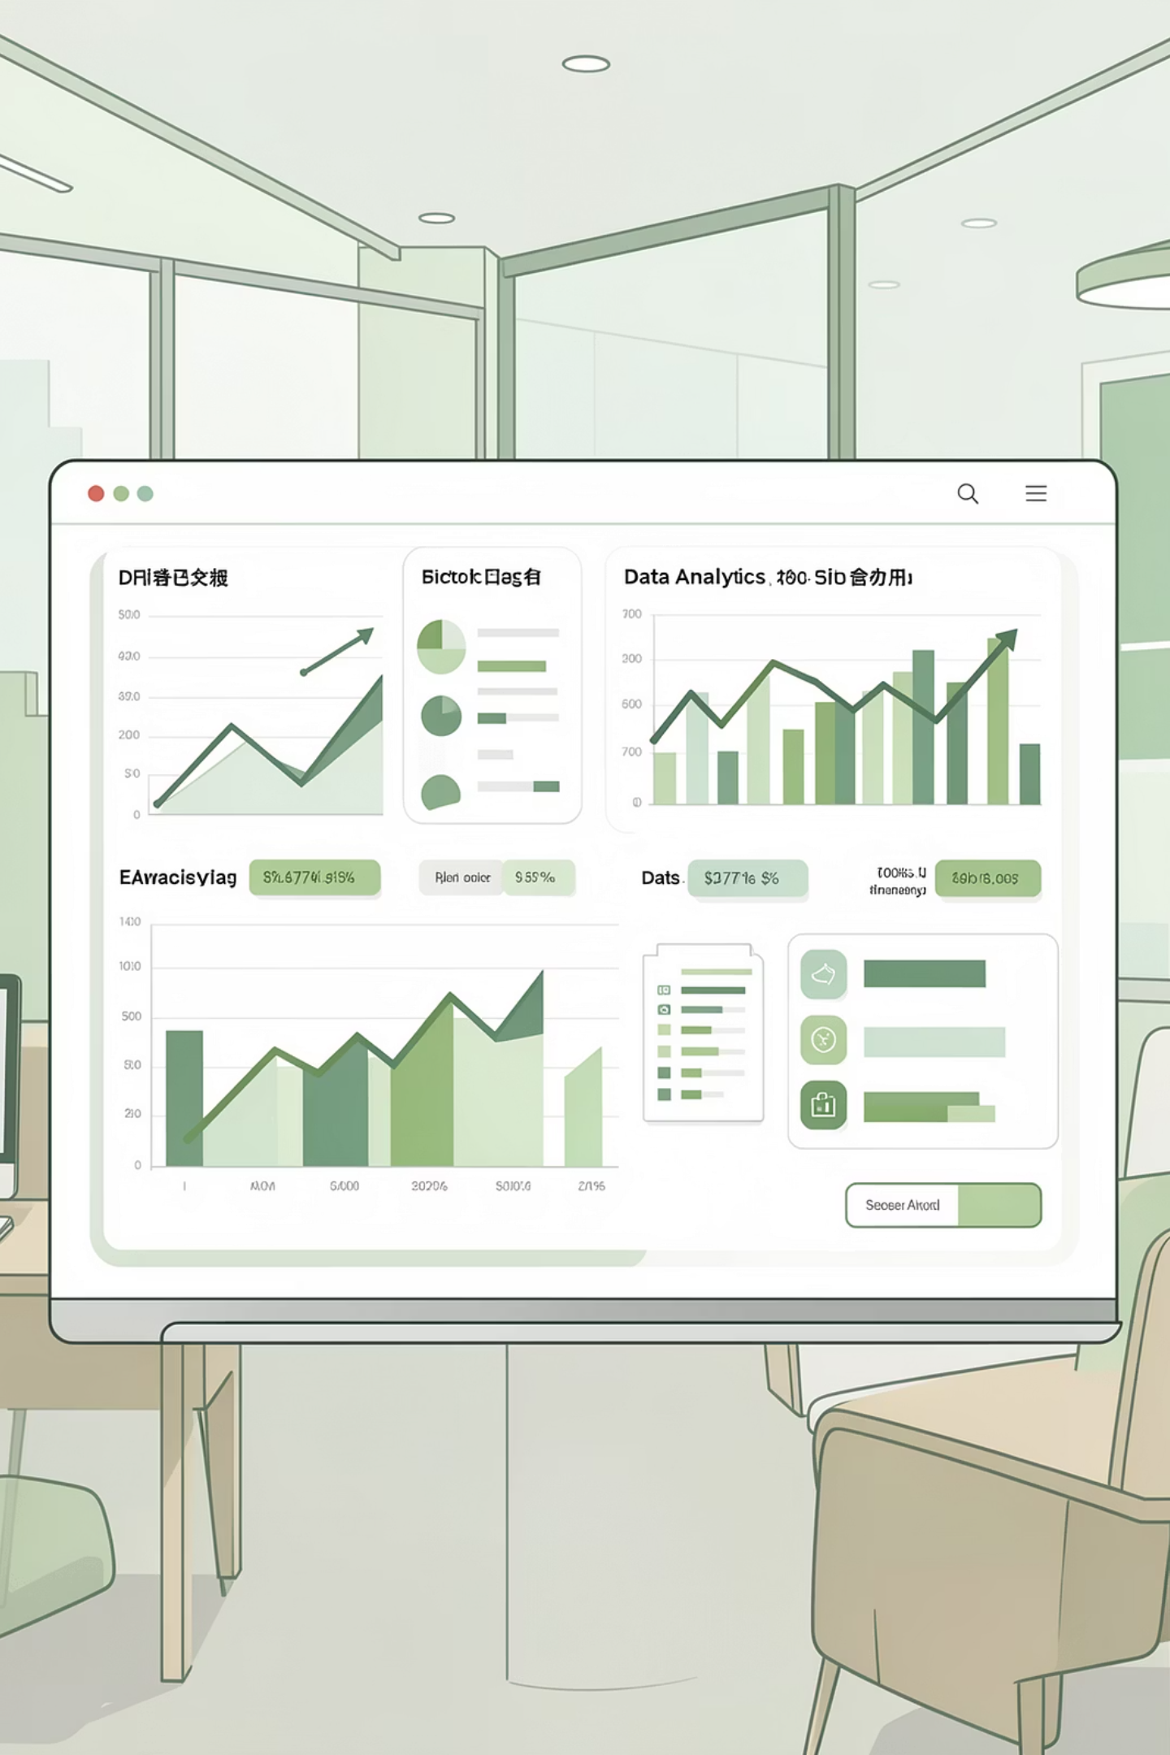
Customer Shopping Behavior Analysis
Uncovering insights from 3,900 purchases to guide strategic business decisions through data-driven analysis of spending patterns, customer segments, and product preferences.

Slide 2

DATASET OVERVIEW
The Foundation: Our Data
3,900
18
50
25
Total Purchases
Data Points
Locations
Products
Transactions analyzed across all categories
Features per customer transaction
Geographic markets represented
Unique items tracked
Dataset includes customer demographics, purchase details, and shopping behavior across four main categories: Clothing, Accessories, Footwear, and Outerwear.

Slide 3
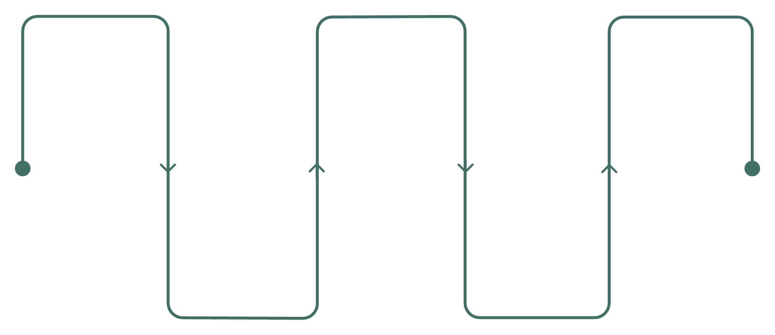
Data Preparation & Cleaning
Python-Powered Analysis
Comprehensive data preparation ensured quality insights:
Load Data
Handle Missing Values
Database Integration
Import CSVs and sources
Imputed 37 missing Review Ratings using category medians
Standardized columns to snake_case format
Created age_group bins for demographic analysis
Removed redundant promo_code_used column
Integrated cleaned data into PostgreSQL
Impute with category medians
Write cleaned tables to DB
Engineer Features
Explore Structure
Create bins and standardize names
Inspect schema and types

Slide 4

Revenue Insights by Gender
Male Customers
Female Customers
$157,890 total revenue
$75,191 total revenue
68% of total revenue generated
32% of total revenue generated
Male customers drive the majority of revenue, presenting opportunities for targeted marketing campaigns and product development strategies.

Slide 5
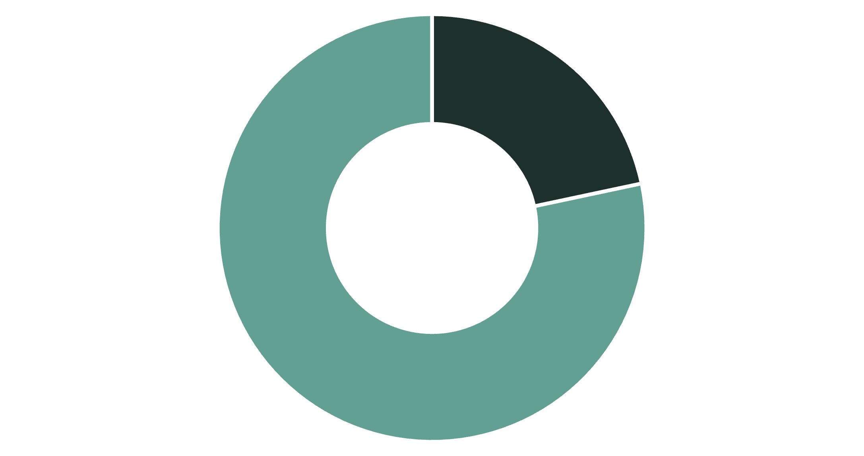
Smart Discount Users
Premium Discount Shoppers
839 customers used discounts while spending above average ($59.76), demonstrating that promotions don't always reduce transaction value.
These savvy shoppers represent 22% of all customers and are prime candidates for loyalty programs.
High Spenders
Other Customers

Slide 6




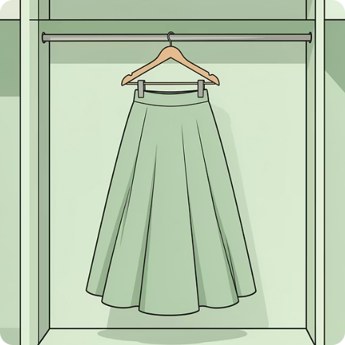
TOP PERFORMERS
Highest-Rated Products
Gloves
Sandals
Boots
Hat
3.86 average rating
3.84 average rating
3.82 average rating
3.80 average rating
Skirt
3.78 average rating

Slide 7

Customer Loyalty Segmentation
Three-Tier Customer Base
Analysis of purchase history reveals distinct customer segments with varying engagement levels:
Loyal Customers
Returning
New Customers
3,116 customers (80%)
701 customers (18%)
83 customers (2%)
Consistent repeat purchasers
Multiple purchases made
First-time buyers

Slide 8
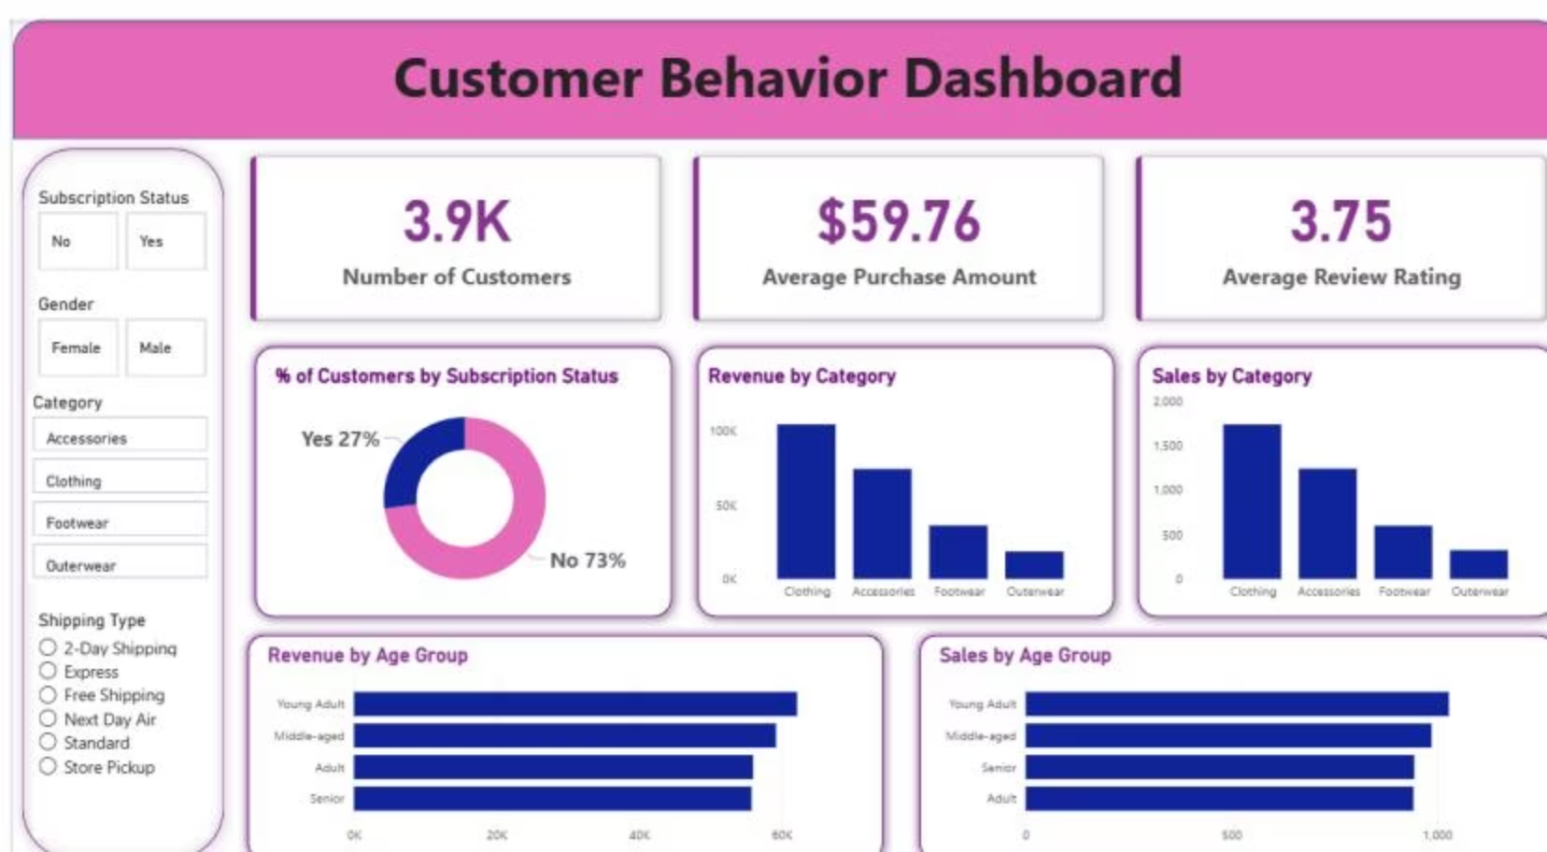
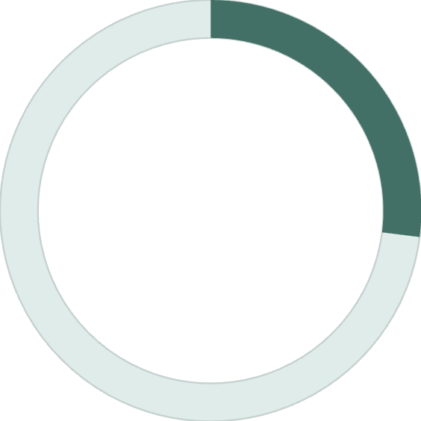
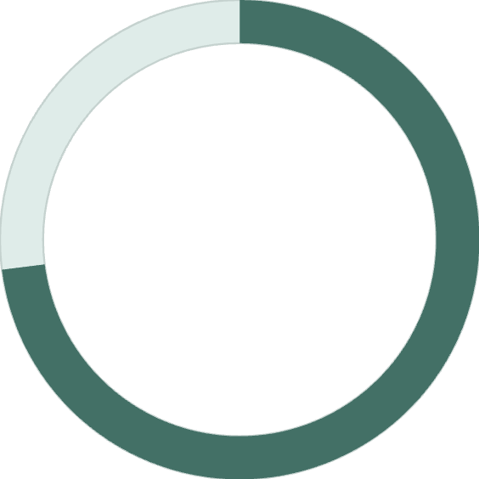
Revenue Performance Dashboard
27%
73%
Subscription Rate
Non-Subscribers
1,053 active subscribers
2,847 customers without subscriptions
Interactive Power BI dashboard reveals Clothing dominates revenue ($100K) while subscription adoption remains low despite loyal customer base.

Slide 9
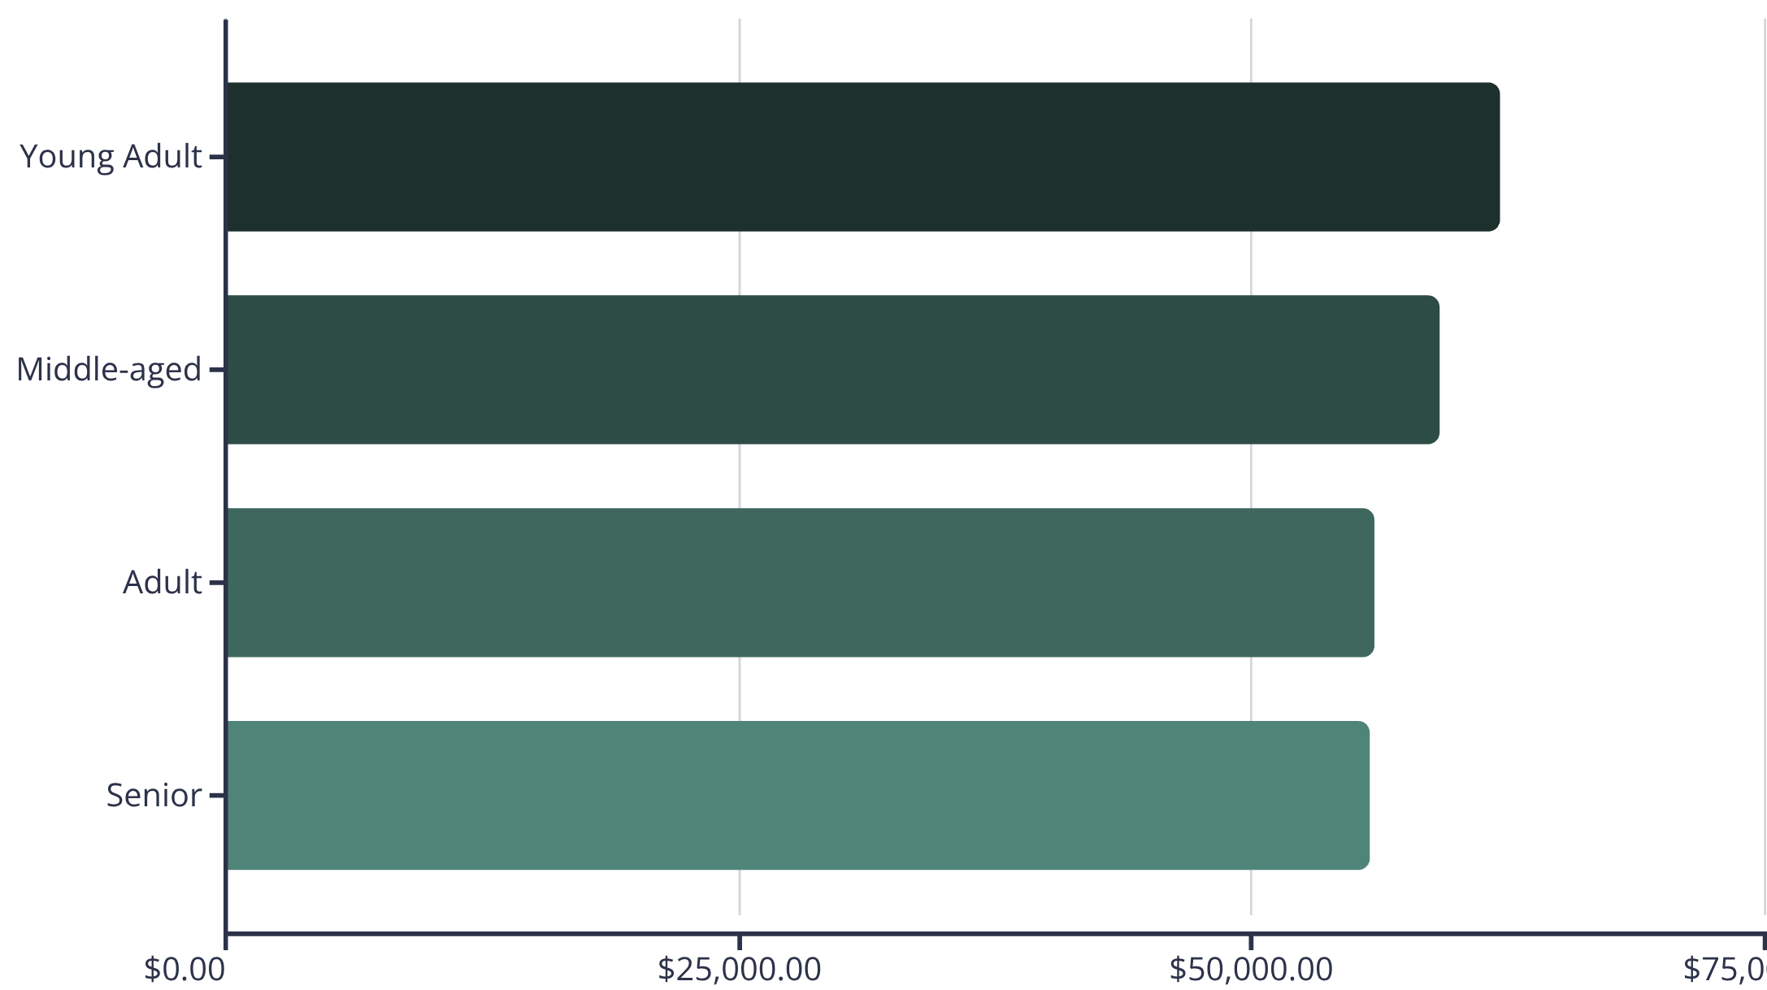
Age Group Revenue Analysis
Demographic Distribution
Young Adults lead revenue generation at $62K, followed closely by Middle-aged customers at $59K.
Relatively balanced spending across age groups suggests broad market appeal with opportunity for age-specific campaigns.

Slide 10
ACTION PLAN
Strategic Recommendations
Boost Subscriptions
1
Promote exclusive benefits to convert the 73% non-subscriber base into recurring revenue
Loyalty Programs
2
Reward repeat buyers to strengthen the 80% loyal customer segment
Review Discount Policy
3
Balance promotional sales boosts with margin control for sustainable growth
Product Positioning
4
Highlight top-rated items (Gloves, Sandals, Boots) in marketing campaigns
Targeted Marketing
5
Focus efforts on high-revenue Young Adults and express-shipping users

